Slide 1
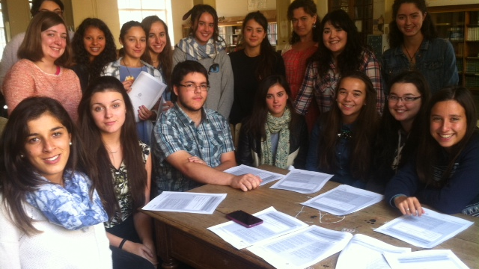
Hypothesis: The magnitude that the economic environment affects graduation rates and success for students

Slide 2
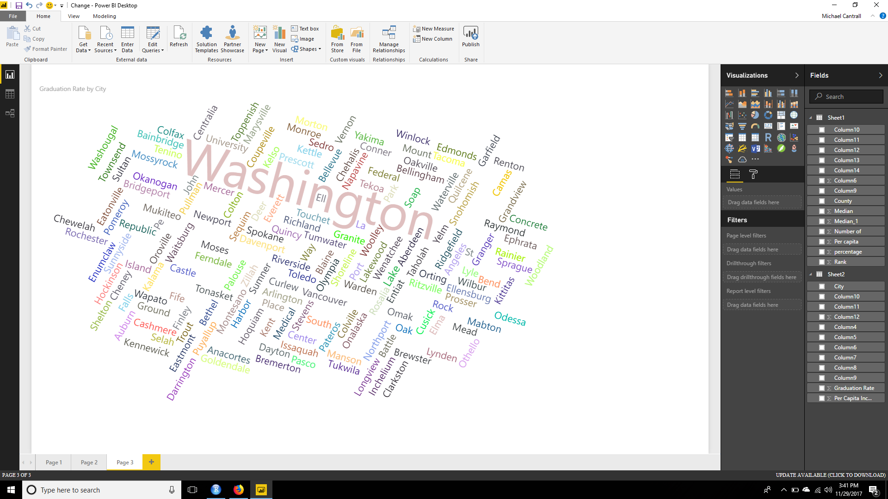
Income Effects on Education
Scope level issues
State, County, City, School District, etc.
Inconsistent labeling scheme.
consistent format (county name, WA)
Scrub data; clean for import/export.
no missing or incomplete data
Aggregate numerical values.
decimal, magnitude, percentage,
Software platform data transfer.
Data parameters explicitly defined.
Excel to software platform .
Notes:
QuickStarter has created an outline to help you get started on your presentation. Some slides include information here in the notes to provide additional topics for you to research.

Slide 3
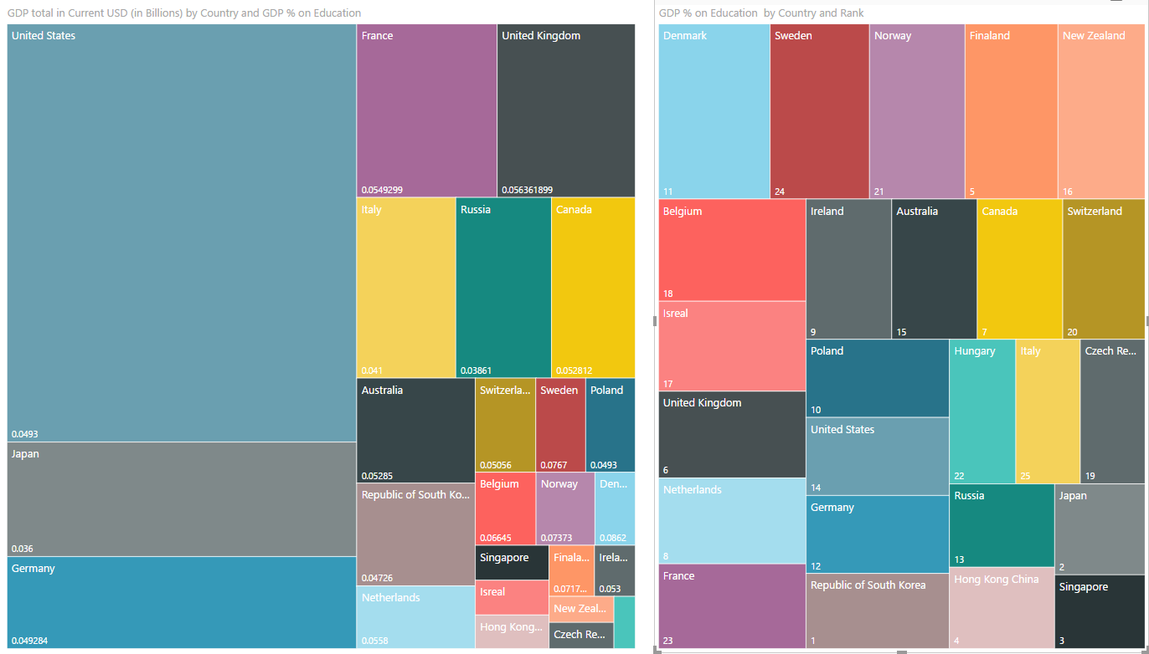

Slide 4
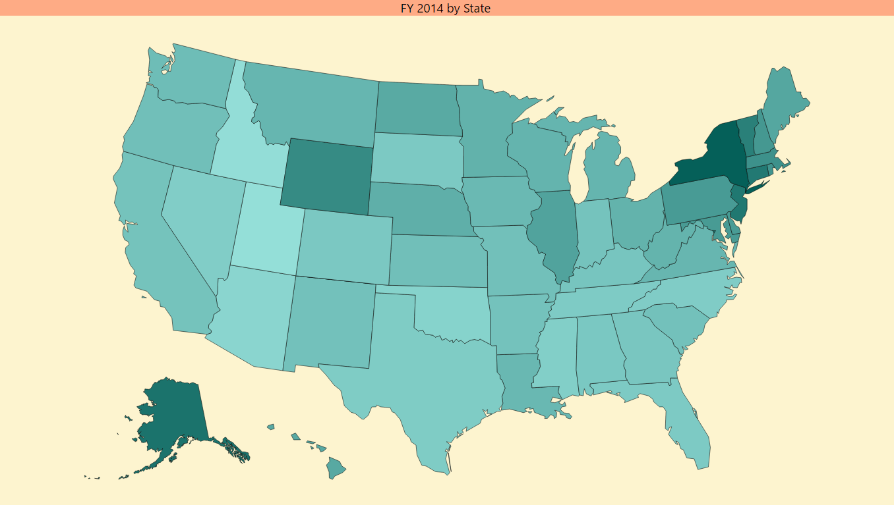
Utah: smallest per student expenditure of $6,500
New York: Largest Per student expenditure $20,610
Washington State: ranks #25 of 51 at $10,202 (Including District of Columbia)
Median income of all states is $13,505

Slide 5
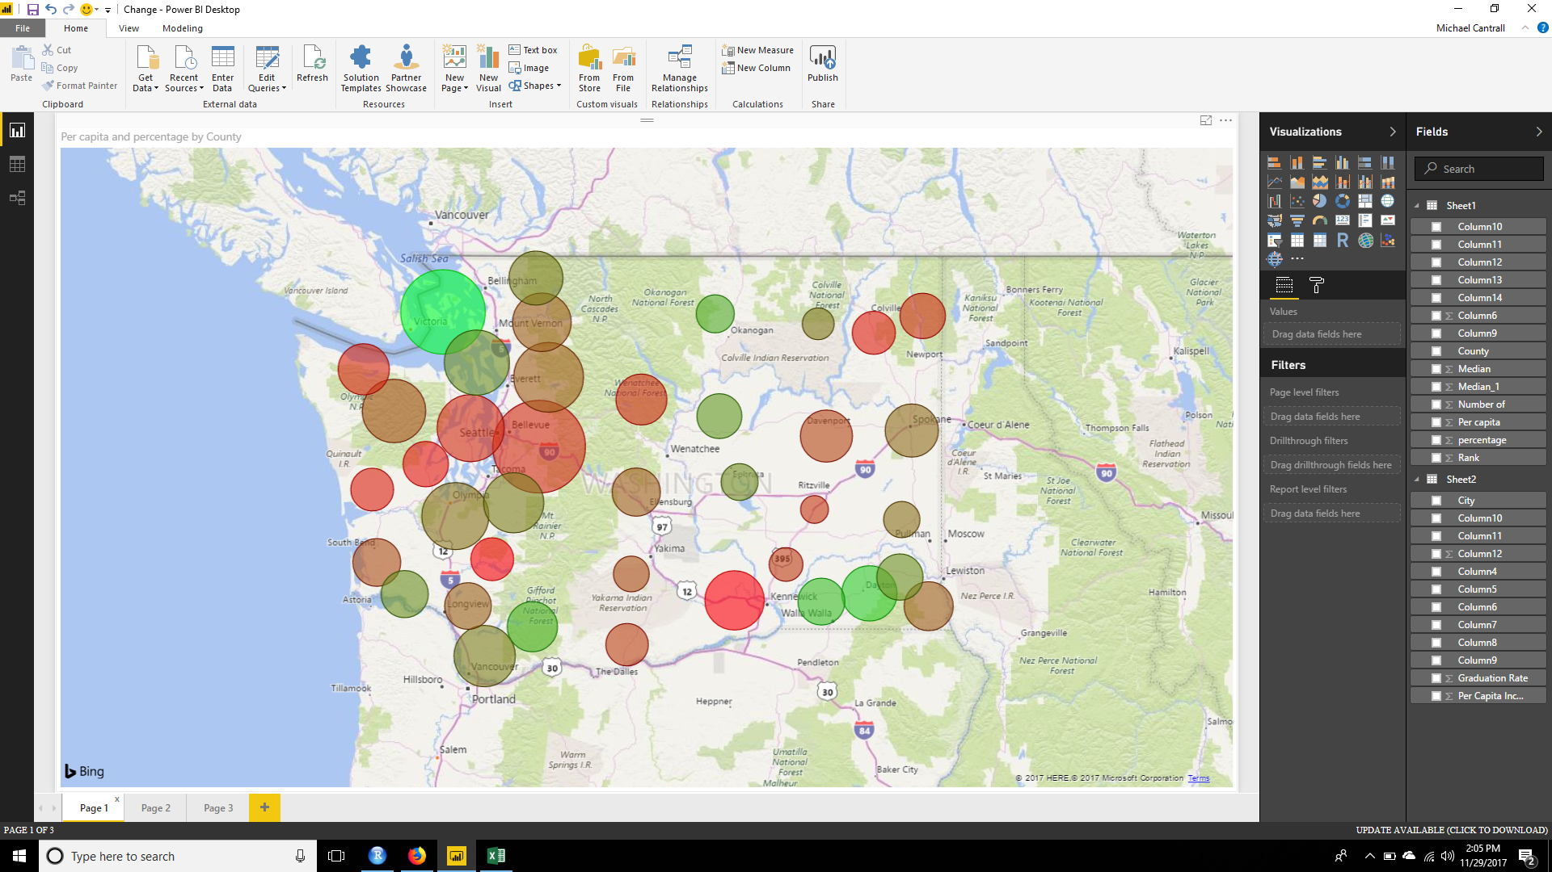
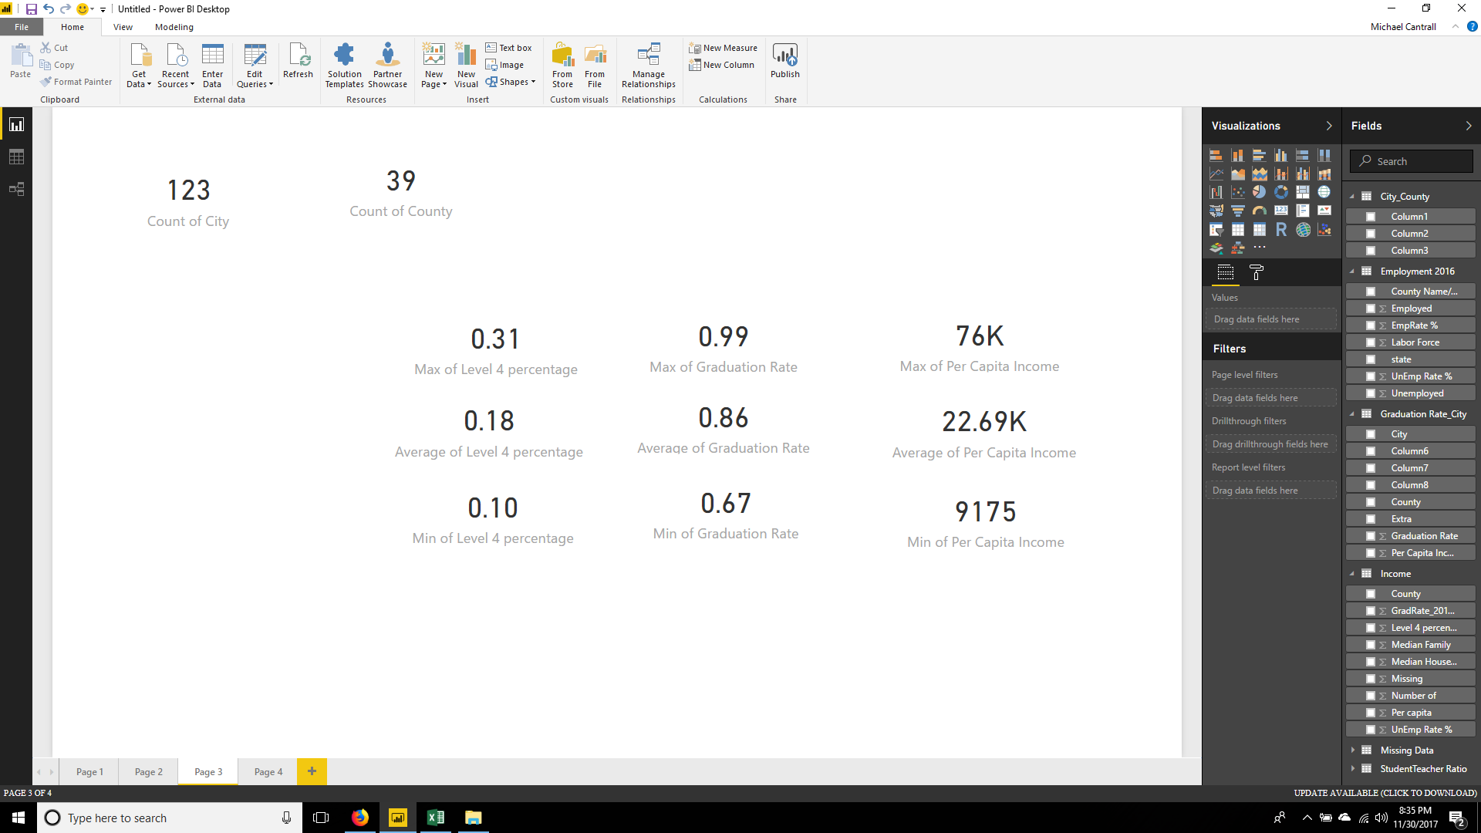
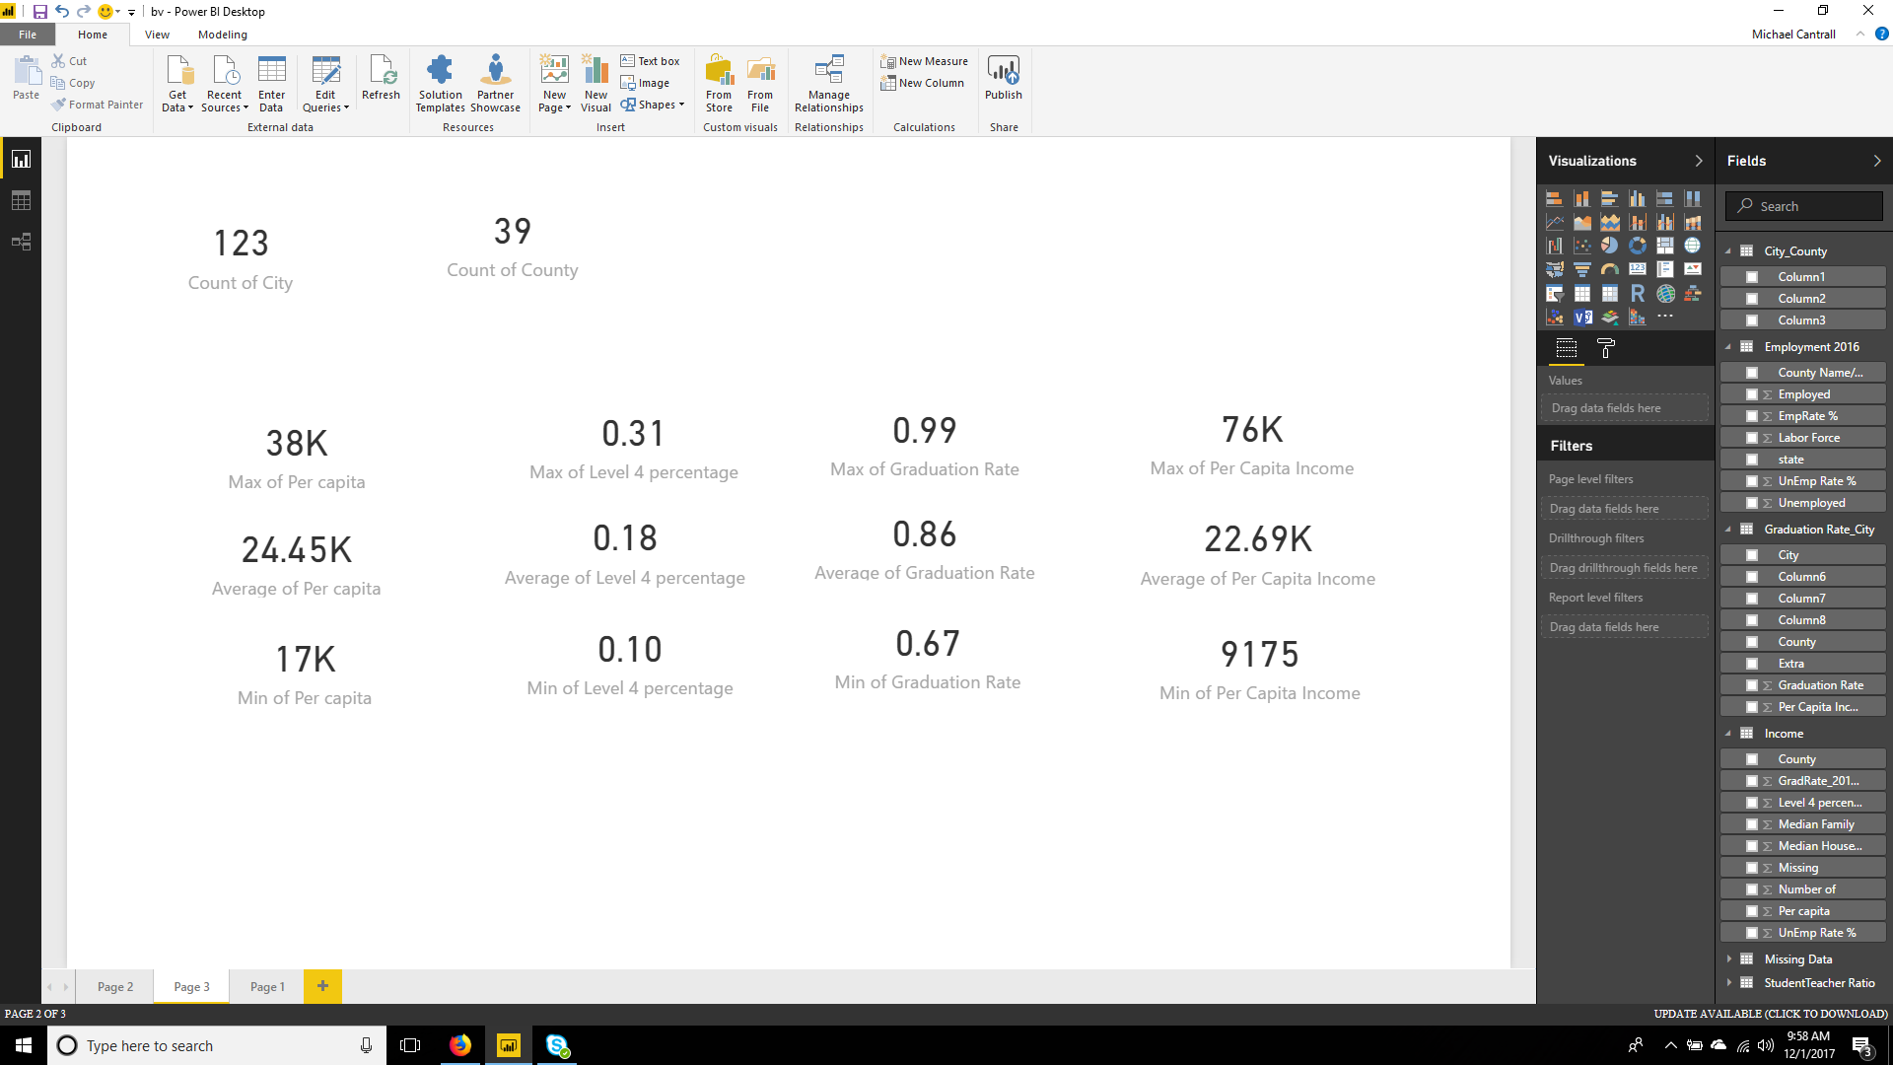

Slide 6
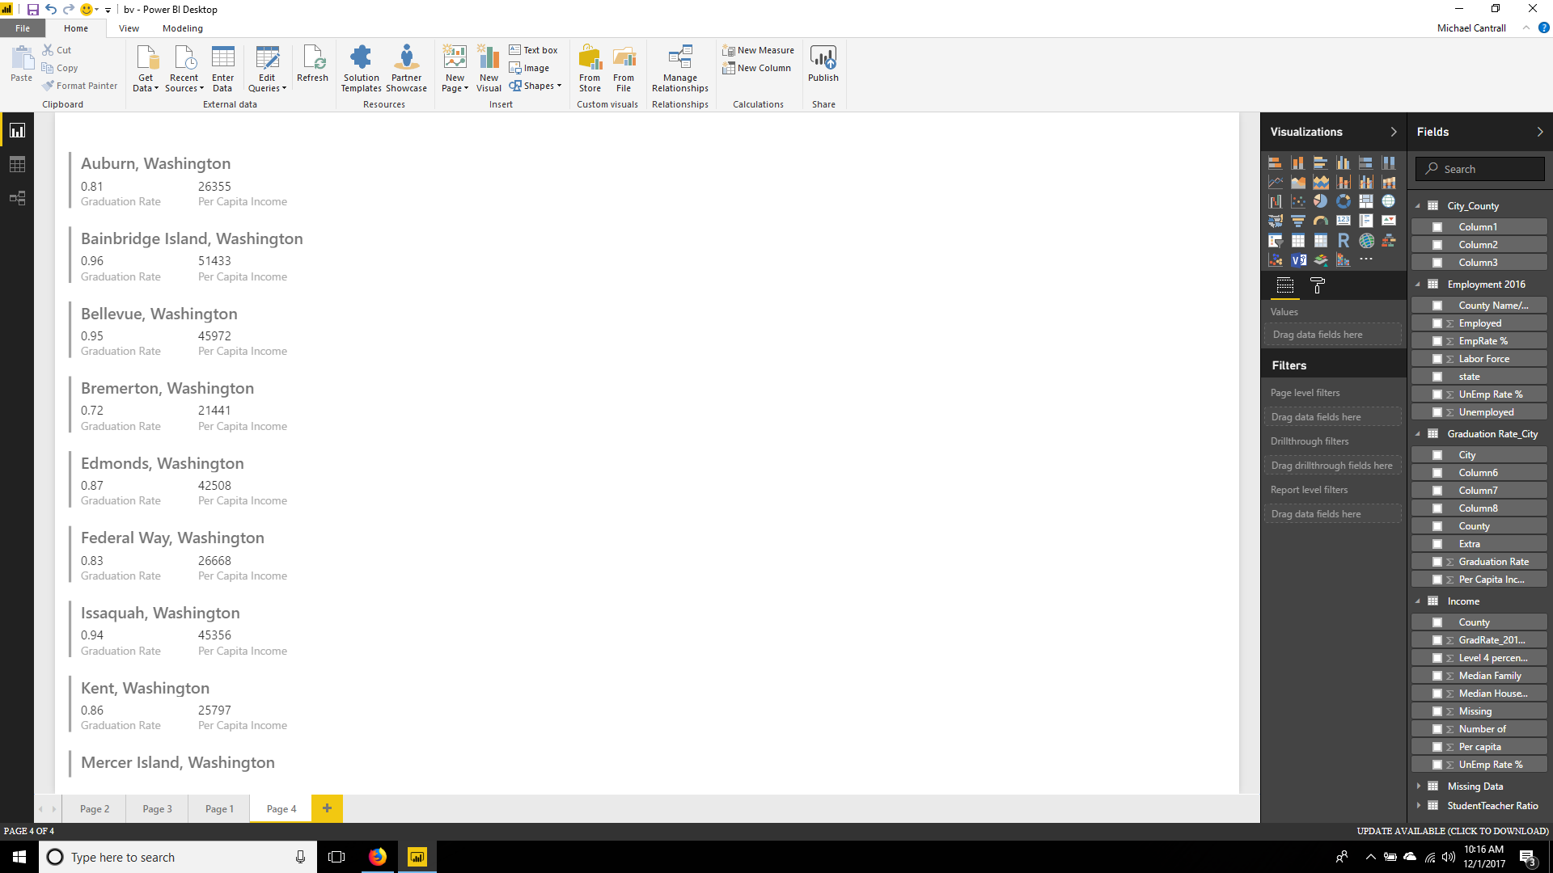

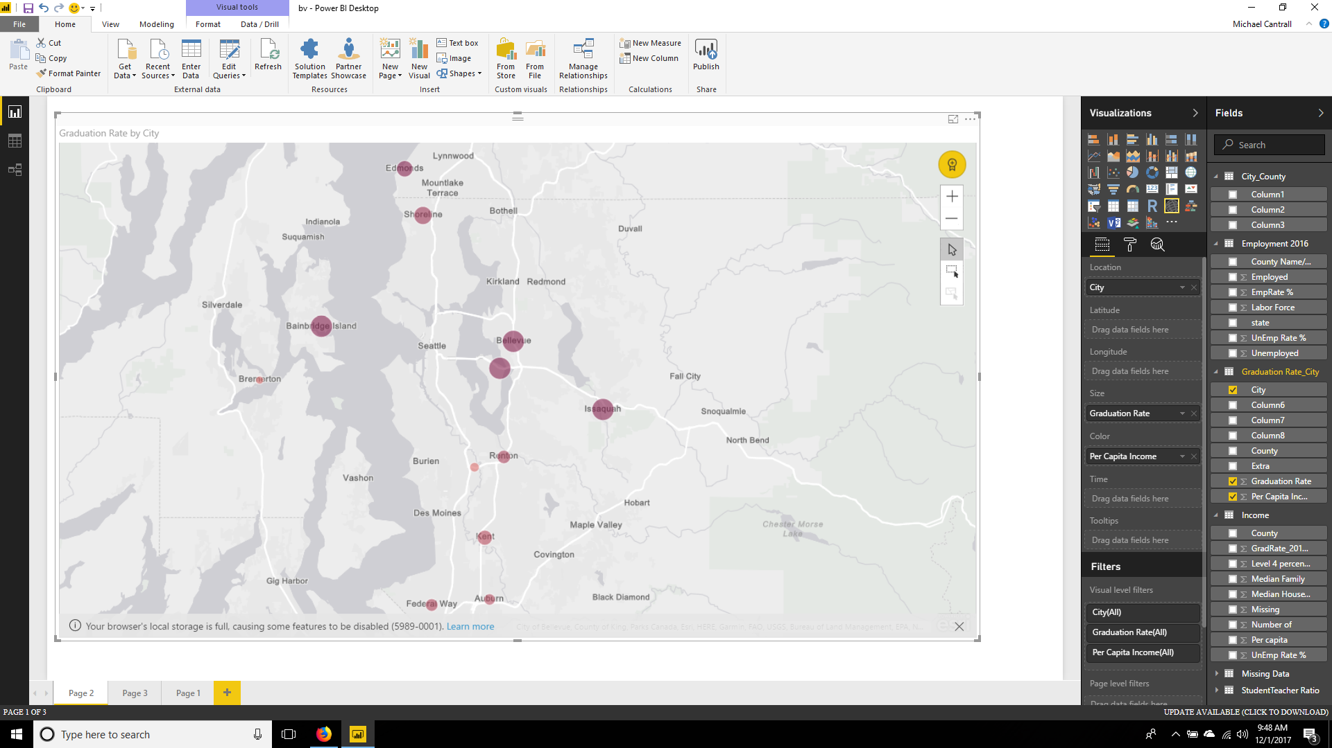
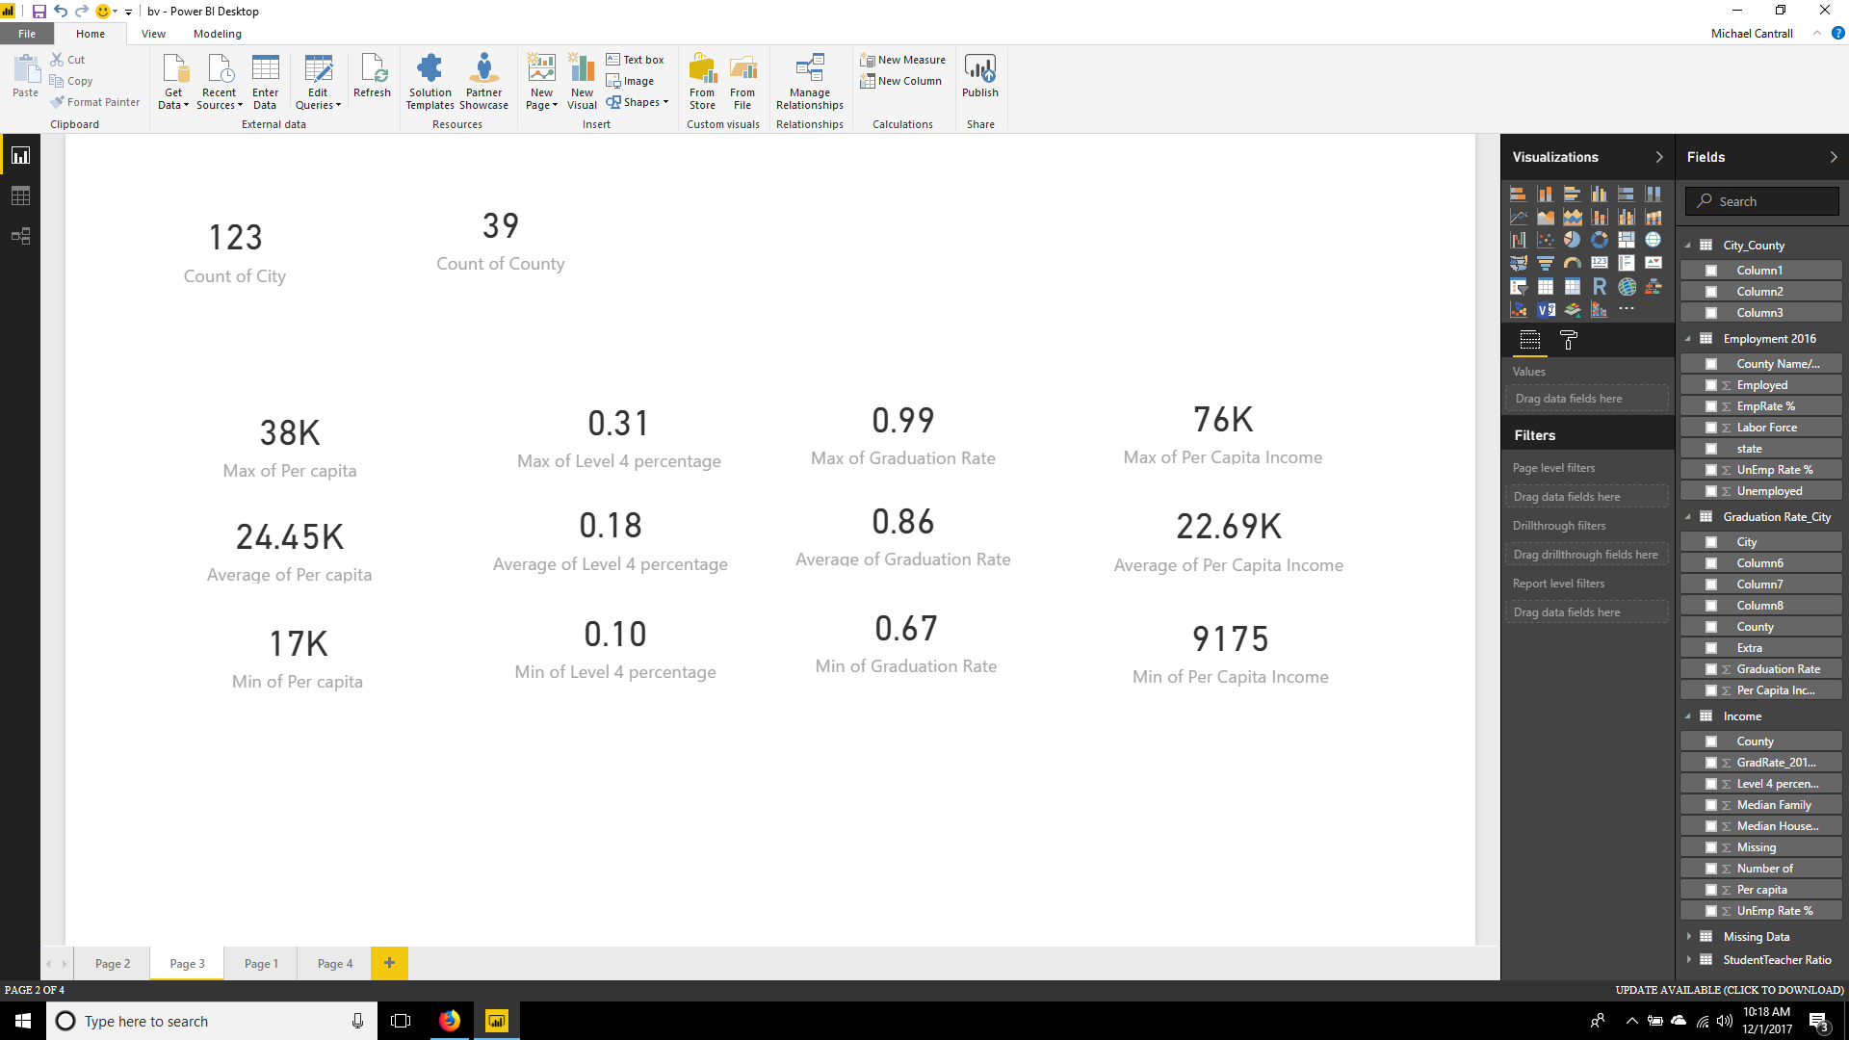

Slide 7
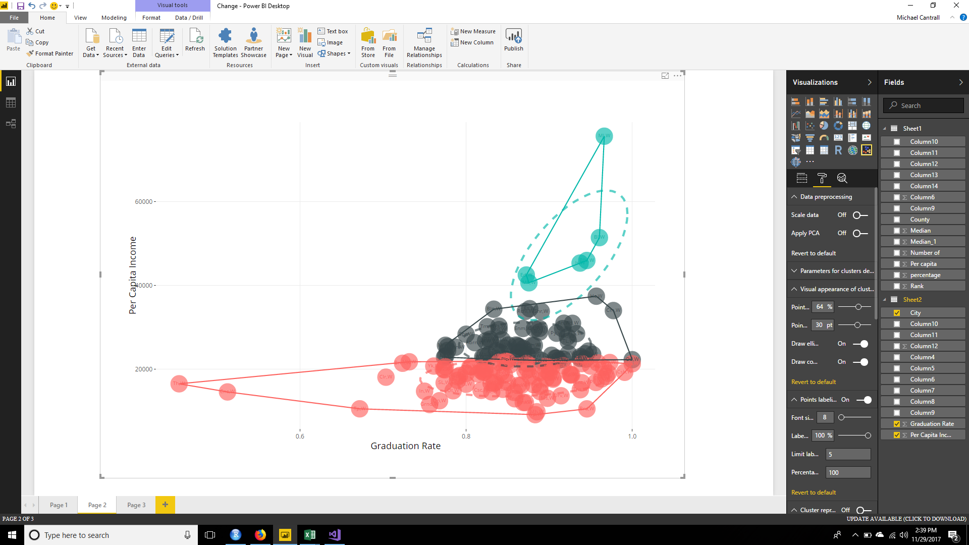


Slide 8
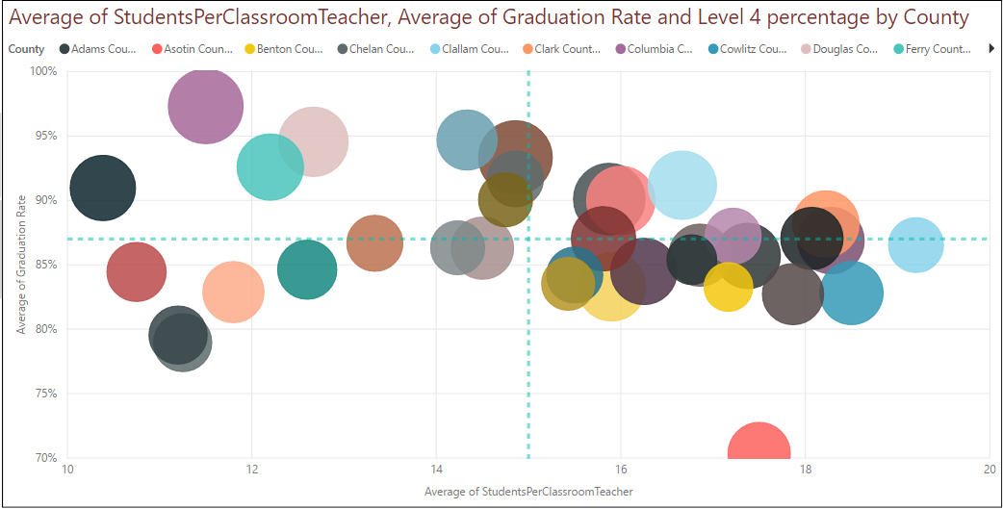
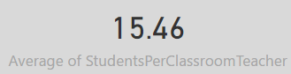
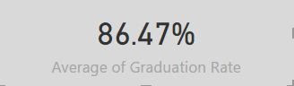

Slide 9
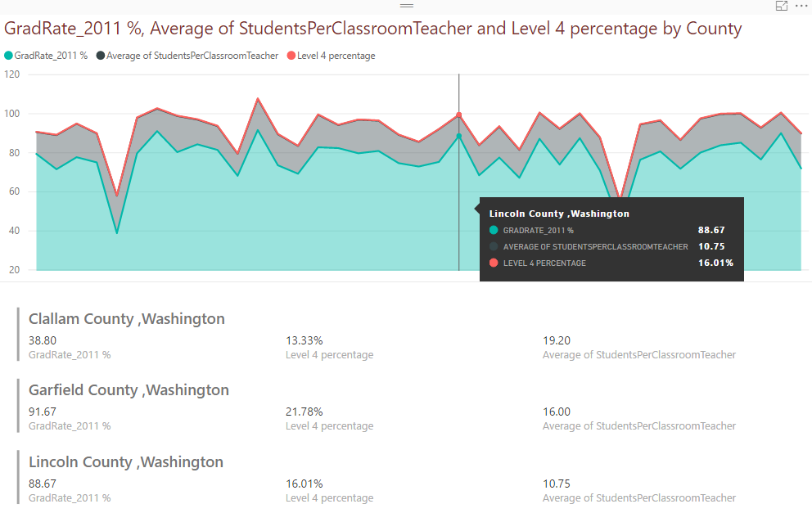

Slide 10
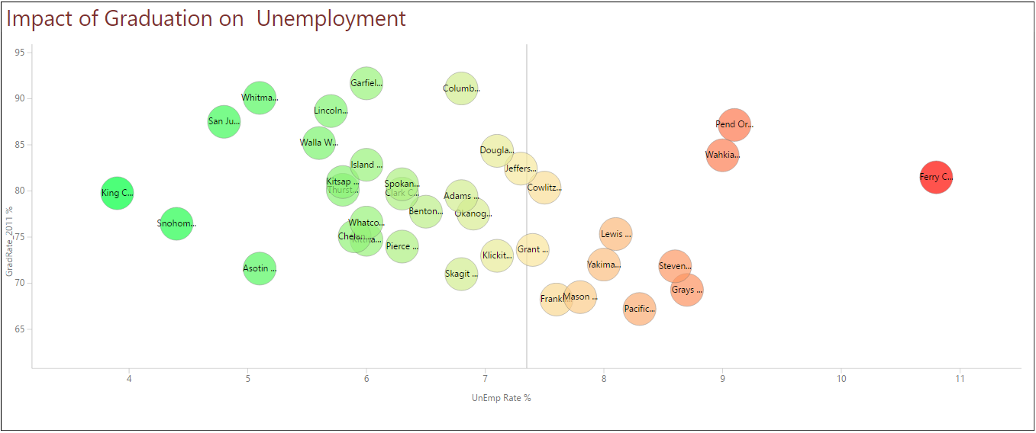

Slide 11
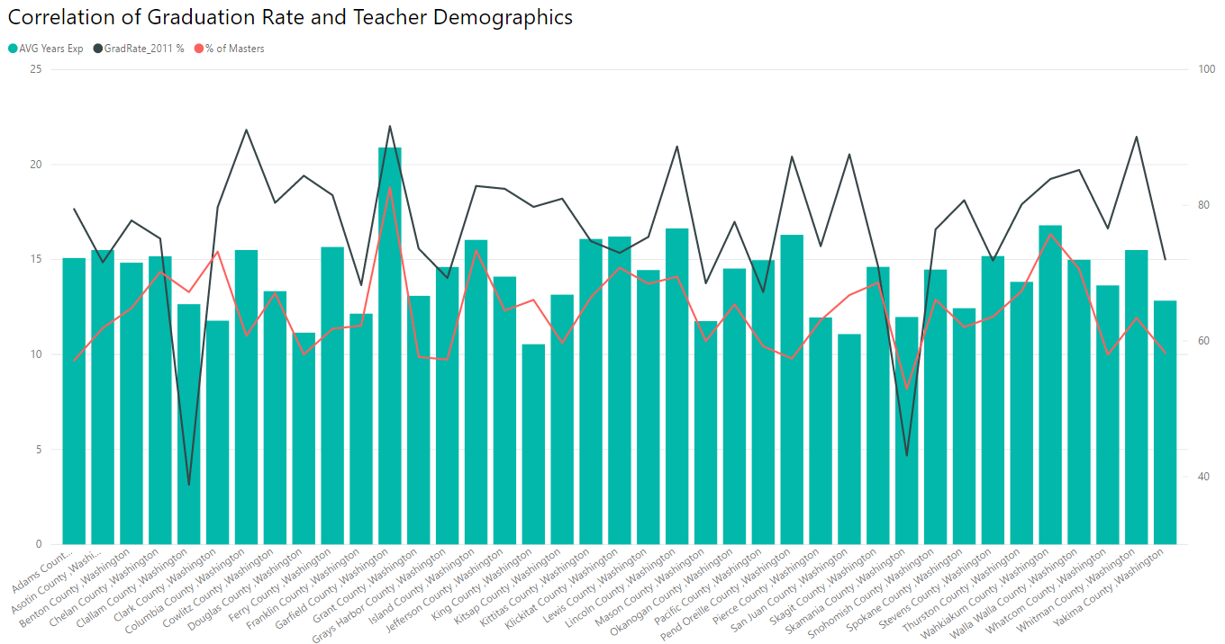

Slide 12
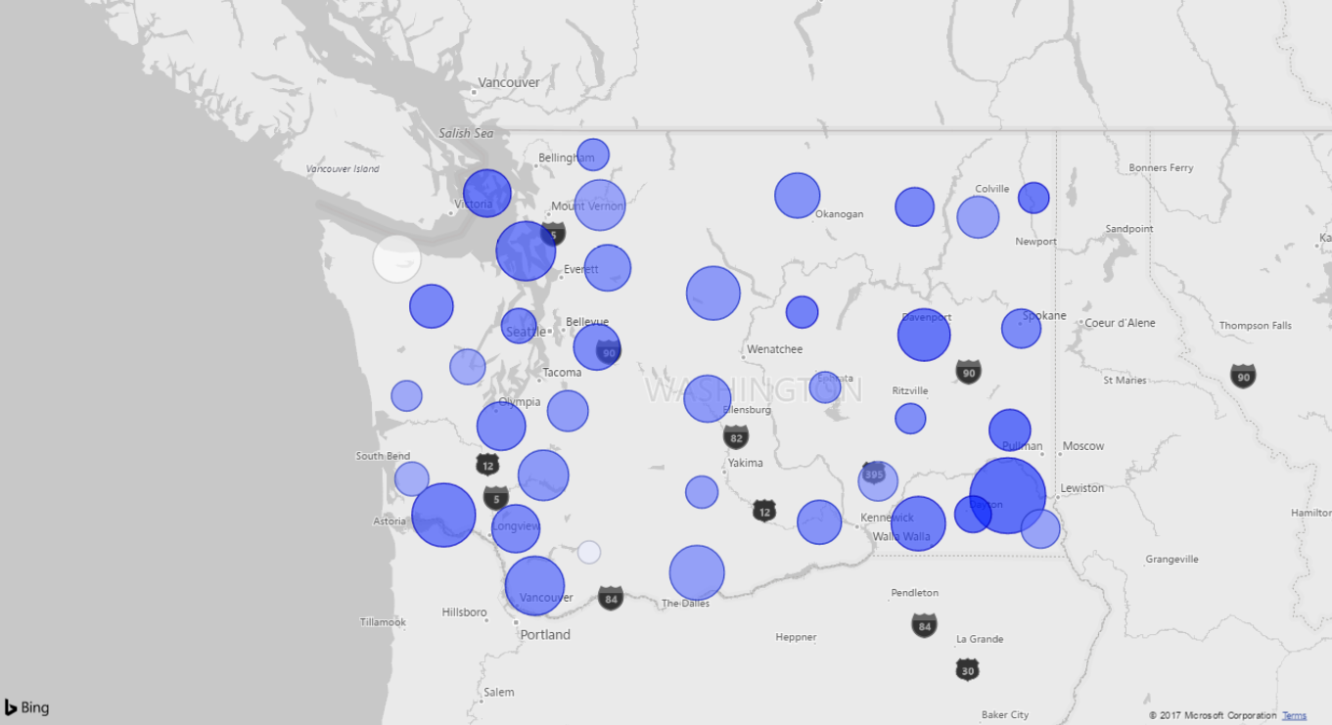
Master’s Degree Education Percentage among Teachers
(Represented by Size)

Slide 13
Work
Cited
https://data.worldbank.org/indicator/SE.XPD.TOTL.GD.ZS?end=2014&start=2014
http://www.imf.org/external/pubs/ft/weo/2014/02/weodata/weorept.aspx
http://reportcard.ospi.k12.wa.us/DataDownload.aspx (Links to an external site.)Links to an external site.
https://en.wikipedia.org/wiki/List_of_Washington_locations_by_per_capita_income
https://www.bls.gov/lau/#cntyaa
https://en.wikipedia.org/wiki/List_of_cities_in_Washington#List_of_cities (Links to an external site.)

